Slide 1
Software Testing Metrics:
Measure the software correctness

Slide 2
Why Metrics in Software Testing?
How would you answer questions such as:
Project oriented questions
How long would it take to test?
How much will it cost to test?
Product oriented questions
How bad/good is the product ?
How many problems still remain in the software?
Test activities oriented questions
Will testing be completed on time?
Was the testing effective?
How much effort went into testing
All these Questions require some type of measurements and record keeping in order to answer properly.

Slide 3
Why??
"We cannot improve what we cannot measure" and Test Metrics helps us to do exactly the same.

Slide 4
Size of Test
Test size attribute may use different metrics:
Amount of time to run test: (bit convoluted ?)
Small size : less than or equal to 3 seconds
Medium size: between 3 seconds and 1 minute
Large size: 1 minute or above
Number of lines of statements to document the test case:
Small size: less than or equal to 3 statements
Medium size: between 4 and 7 statements
Large size: 8 or more statements
Any suggestions - - - - ? Number of test cases? --- or
--- type of test such as unit test versus integration test ?----

Slide 5
Quality : # of Problems
The attribute , Quality, is often measured with the metric of number of problems found; but number of problems alone does not tell the whole story - - - consider
Severity of problems
High
Medium
low
Type of problems
UI
Database
Network outage
Etc.

Slide 6
Quality (cont.)
Both Severity and Type are important
# of problems found by severity
# of problems found by type
# of problems found when (when during development)
# of problems found when (months after release)
# of problems found where (UI,DB, Logic, Network, etc.)
Quality Information is relevant to both:
Software providers
Customers/users
Why important to users? What would they do with it?

Slide 7
Problem Fix Rate
Problem
Fix Rate
Problem Find Rate
During Functional Test
# of Problems
Fixed per hour
Problem Fix Rate
During Functional Test
Time
Day
1
Day
2
Day
3
Day
4
Day
5
Would this fix rate present a problem ?
Would you also want to keep a backlog # by day ?

Slide 8
Problem Density
Density
6
Note: Just the # of problems
found by area does not
normalize the measurement;
we need the per KLOC.
5
# of problems
found per KLOC
4
3
2
1
Area
Module 1
Module 2
Module 3
Module 4

Slide 9
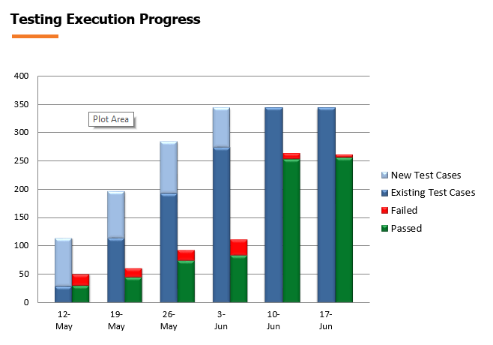

Slide 10
Test Coverage Rate
Not all the planned test cases are actually run.
# of test cases executed / # of test cases planned
By functional areas
By test phases
# of source statements executed / total # of source statements
By functional areas
By modules

Slide 11
Test Activity Effectiveness
Defect discovery and eradication activities occur at all phases of development. To see which is more effective one may use:
# of problems found / total # of problems found
By development phase (req. rev., design rev., func. test, system, etc.)
# of problems found / person-days of effort
By test activities (e.g. boundary value testing, branch testing, d-u testing, etc.)

Slide 12
Fix Effectiveness
Not all problem fixes resolve the problems.
# of fixes that worked / total # of fixes
The first time
# of fixes that required more than 1 fix / total number of fixes

Slide 13
Fix Cost
Fix cost is usually measured by amount of effort expended.
# of person-hours expended / fix
By severity
By areas
By phase type (including post-release)
If the fix cost for post-release is higher than that of all of the pre-release phases,
then that will be one reason for test and reviews.

Slide 14
Test Metrics
Defect Severity Index: It is the degree of impact a defect has on the development of an operation or a component of a software application being tested. Defect severity index (DSI) offers an insight into the quality of the product under test and helps gauge the quality of the test team’s efforts. Additionally, with the assistance of this metric, the team can evaluate the degree of negative impact on the quality as well as the performance of the software. Following formula is used to measure the defect severity index.
Defect Severity Index (DSI) = Sum of (Defect * Severity Level) / Total number of defects

Slide 15
Test Metrics
Test Case Effectiveness: The objective of this metric is to know the efficiency of test cases that are executed by the team of testers during every testing phase. It helps in determining the quality of the test cases.
Test Case Effectiveness = (Number of defects detected / Number of test cases run) x 100
Test Case Productivity: This metric is used to measure and calculate the number of test cases prepared by the team of testers and the efforts invested by them in the process. It is used to determine the test case design productivity and is used as an input for future measurement and estimation. This is usually measured with the assistance of the following formula:
Test Case Productivity = (Number of Test Cases / Efforts Spent for Test Case Preparation)

Slide 16
Test Metrics
Test Effectiveness: A contrast to test efficiency, test effectiveness measures and evaluates the bugs and defect ability as well as the quality of a test set. It finds defects and isolates them from the software product and its deliverables. Moreover, the test effectiveness metrics offer the percentage of the difference between the total number of defects found by the software testing and the number of defects found in the software. This is mainly calculated with the assistance of the following formula:
Test Effectiveness (TEF) = (Total number of defects injected + Total number of defects found / Total number of defect escaped) x 100

Slide 17
Test Tracking & Efficiency:
Passed Test Cases Coverage: It measures the percentage of passed test cases.
(Number of passed tests / Total number of tests executed) x 100
Failed Test Case Coverage: It measures the percentage of all the failed test cases.
(Number of failed tests / Total number of test cases failed) x 100
Test Cases Blocked: Determines the percentage of test cases blocked, during the software testing process.
(Number of blocked tests / Total number of tests executed) x 100
Fixed Defects Percentage: With the assistance of this metric, the team is able to identify the percentage of defects fixed.
(Defect fixed / Total number of defects reported) x 100

Slide 18
Test Tracking & Efficiency:
Accepted Defects Percentage: The focus here is to define the total number of defects accepted by the development team. These are also measured in percentage.
(Defects accepted as valid / Total defect reported) x 100
Defects Rejected Percentage: Another important metric considered under test track and efficiency is the percentage of defects rejected by the development team.
(Number of defects rejected by the development team / total defects reported) x 100
Defects Deferred Percentage: It determines the percentage of defects deferred by the team for future releases.
(Defects deferred for future releases / Total defects reported) x 100
Critical Defects Percentage: Measures the percentage of critical defects in the software.
(Critical defects / Total defects reported) x 100

Slide 19
Example of Test Metric
Rework Effort Ratio = (Actual rework efforts spent in that phase/ total actual efforts spent in that phase) X 100
Requirement Creep = ( Total number of requirements added/No of initial requirements)X100
Schedule Variance = ( Actual efforts – estimated efforts ) / Estimated Efforts) X 100
Cost of finding a defect in testing = ( Total effort spent on testing/ defects found in testing)
Schedule slippage = (Actual end date – Estimated end date) / (Planned End Date – Planned Start Date) X 100
Passed Test Cases Percentage = (Number of Passed Tests/Total number of tests executed) X 100

Slide 20
Example of Test Metric
Failed Test Cases Percentage = (Number of Failed Tests/Total number of tests executed) X 100
Blocked Test Cases Percentage = (Number of Blocked Tests/Total number of tests executed) X 100
Fixed Defects Percentage = (Defects Fixed/Defects Reported) X 100
Accepted Defects Percentage = (Defects Accepted as Valid by Dev Team /Total Defects Reported) X 100
Defects Deferred Percentage = (Defects deferred for future releases /Total Defects Reported) X 100

Slide 21
Example of Test Metric
Critical Defects Percentage = (Critical Defects / Total Defects Reported) X 100
Average time for a development team to repair defects = (Total time taken for bugfixes/Number of bugs)
Number of tests run per time period = Number of tests run/Total time
Test design efficiency = Number of tests designed /Total time
Test review efficiency = Number of tests reviewed /Total time
Bug find rote or Number of defects per test hour = Total number of defects/Total number of test hours

Slide 22
End

